Slide 1
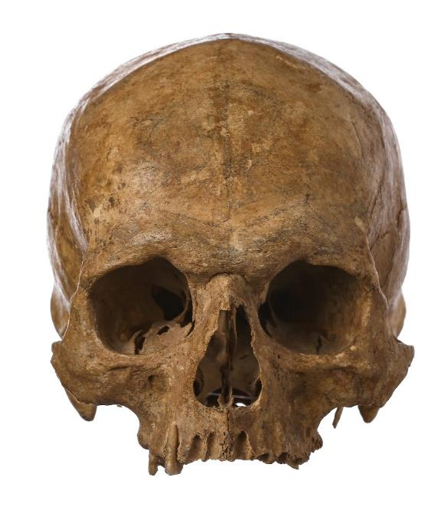
Princes in the Tower
Dye Electrophoresis Lab

Slide 2
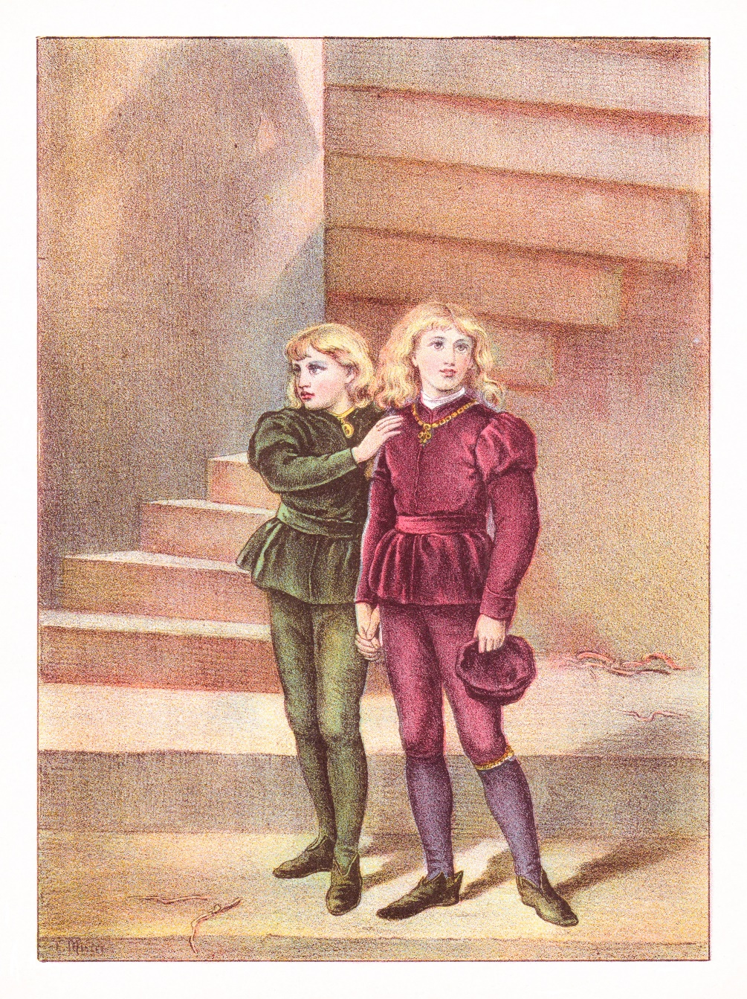
Overview of today’s lab
Today, you will use DNA analysis to investigate a famous historical mystery!
In 1483, two English princes vanished and were never seen again. Have their remains been discovered?

Slide 3
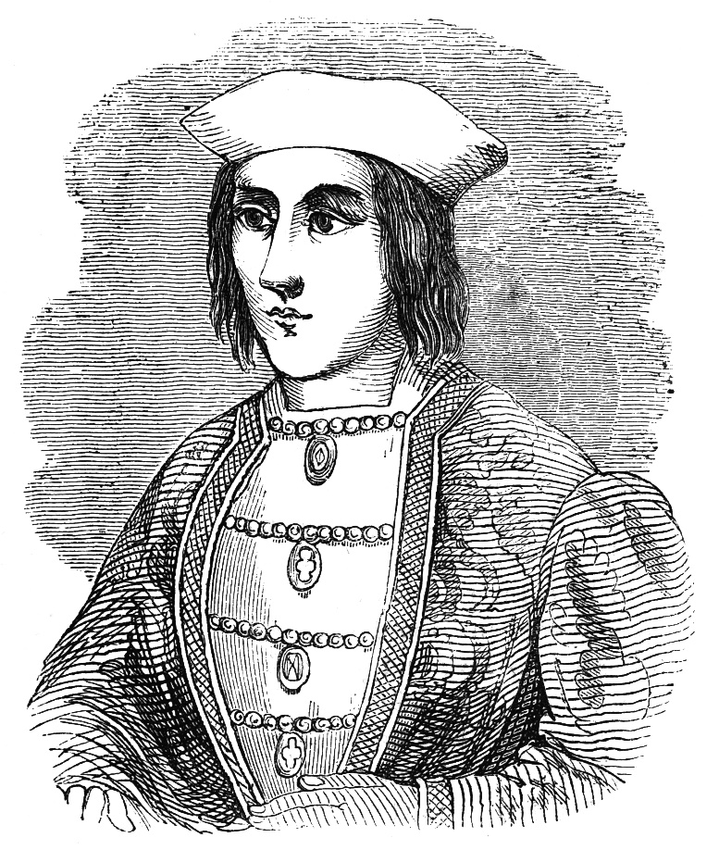
A brief history lesson: King Edward IV
King Edward IV was the English monarch from 1461 until his sudden death in 1483.
At the time of King Edward IV’s death, his heirs, Prince Edward and Prince Richard, were only 12 and 9 years old, respectively.
King Edward IV appointed his brother to serve as head of state until Prince Edward came of age.

Slide 4
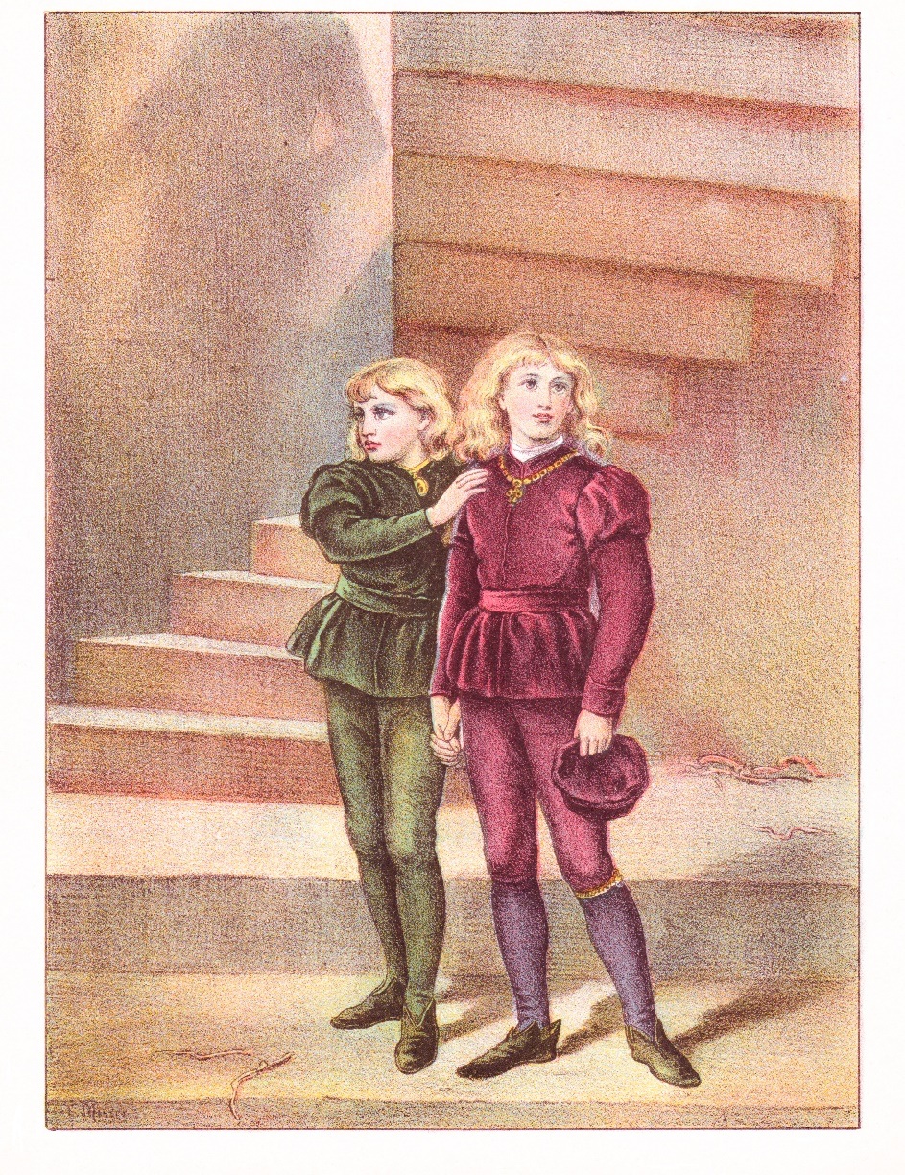
A brief history lesson: The Princes in the Tower
However, the princes were declared illegitimate, and their uncle was crowned King Richard III.
The princes were held in the Tower of London but mysteriously disappeared in the summer of 1483.
No one knows what happened to the princes, but many assume they were murdered by order of their uncle, King Richard III.

Slide 5
Princes in the Tower found?
Two pairs of remains suspected to belong to Prince Edward and Prince Richard have been discovered.
The best way to identify the remains is to use forensic DNA testing.

Slide 6
Using DNA for identification
Forensic scientists use DNA analysis to solve crimes and identify remains.
To understand why DNA analysis is the most powerful tool for identification, we need to review some background on DNA.

Slide 7

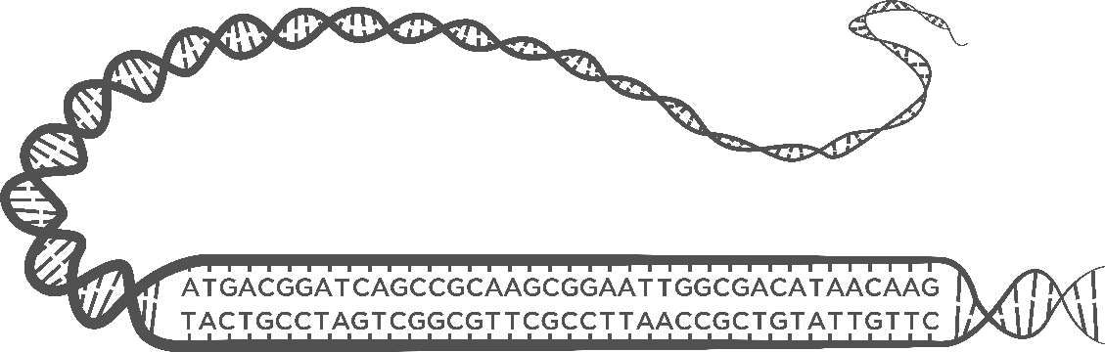
Using DNA for identification
DNA is made of four bases abbreviated A, T, C, and G.
The order of the As, Ts, Cs, and Gs is referred to as the DNA sequence.
Every person has a unique DNA sequence, which can be used like a fingerprint to uniquely identify them.
Chromosomes
DNA
DNA sequence

Slide 8
DNA as a unique identifier
However, more than 99% of DNA sequences are the same in all humans.
Forensic scientists focus on the areas of DNA that differ between individuals.
Forensic analysis usually examines regions of the DNA that differ in length called STRs.

Slide 9
Short tandem repeats (STRs)
STRs are 2-6 base sequences that repeat in tandem (in a row).
There are many places in our DNA that contain STRs. We will refer to a specific location that contains an STR as an STR region.
GATA
GATA
GATA
GATA

Slide 10
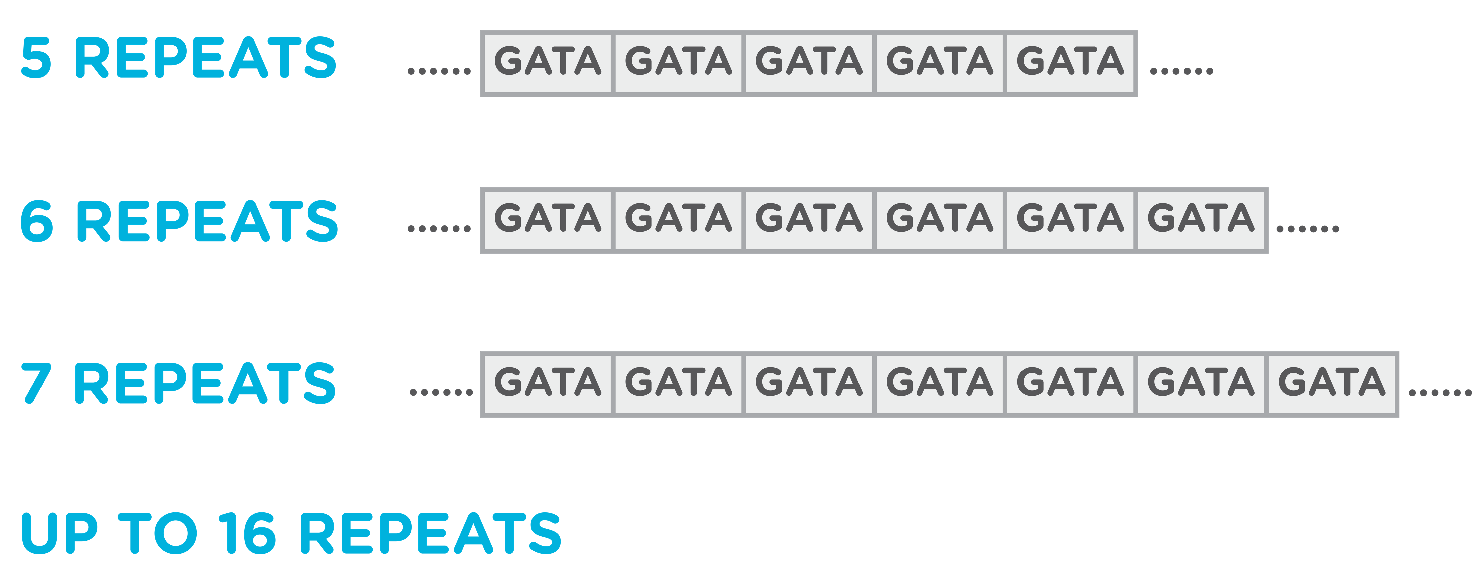
Short tandem repeats (STRs)
For a given STR region, the chromosomal location and the sequence that is repeated are the same in all people.
However, the number of repeats can vary between people.
Location: Chromosome 7
Sequence repeated: GATA
Number of repeats: Between 5 and 16

Slide 11

STR genotypes
Humans have two copies of each chromosome, one inherited from each biological parent.
Because of this, humans have two copies of each STR region.
The number of repeats you inherit from each parent might differ.
Maternal chromosome
STR region
Paternal chromosome

Slide 12
STR genotypes
Forensic scientists refer to STR alleles by the number of repeats they contain.
This person is “9, 9” for this STR region.
Person A
STR Genotype: 9,9
9 repeats
9 repeats

Slide 13
STR genotypes
Person A
Person B
STR Genotype: 9,9
STR Genotype: 5,7
9 repeats
5 repeats
9 repeats
7 repeats

Slide 14


Using STR genotypes for familial matching
STR genotypes can be used to test biological relationships, like paternity.
Let’s examine the two people from the previous slide.
We will use color-coding to track their chromosomes, and we will annotate the number of repeats on the chromosome instead of looking at the DNA sequence.
9 repeats
5 repeats
9 repeats
7 repeats
7 repeats

Slide 15

What are the possible STR genotypes for offspring from these parents?
Parents
9 repeats
5 repeats
9 repeats
7 repeats
7 repeats
This parent can only pass on the 9 allele
This parent can pass on the 5 or the 7 allele
Possible offspring
5 repeats
7 repeats
9 repeats
9 repeats

Slide 16
Using STR genotypes to identify unknown remains
When the identity of unknown remains is suspected, forensic scientists can attempt to identify the remains through familial matching.
Imagine a child from those same parents was missing:
9 repeats
5 repeats
9 repeats
7 repeats
7 repeats

Slide 17
Using STR genotypes to identify unknown remains
Parents
9 repeats
5 repeats
9 repeats
7 repeats
7 repeats
Unidentified remains
6 repeats
8 repeats
Unidentified remains with this STR genotype could not be their missing child

Slide 18
Using STR genotypes to identify unknown remains
Parents
9 repeats
5 repeats
9 repeats
7 repeats
7 repeats
Unidentified remains
5 repeats
9 repeats
Unidentified remains with this STR genotype could possibly be their missing child

Slide 19
STR DNA profiles
By comparing STR genotypes at 20 STR regions, forensic scientists create DNA profiles that can be used for identification.
For simplicity, in this activity we will focus on a single STR region.

Slide 20
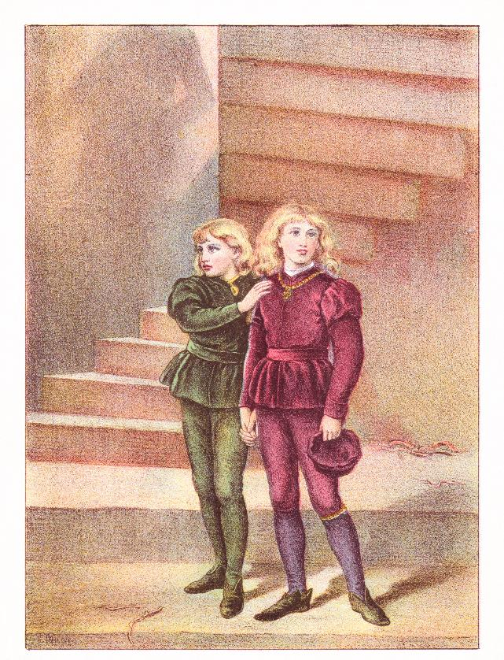
Today’s lab
Remember, Prince Edward and Prince Richard disappeared while imprisoned in the Tower of London.
Over the years, two pairs of remains have been found that have been speculated to belong to the lost princes.
Your goal is to test the unknown remains to determine if any might belong to the princes!

Slide 21

Today’s lab: Princes found?
In 1674, one pair of remains was found under a stairwell in the Tower of London, the last known location of the princes.
Preliminary forensic analysis performed in 1933 determined that the remains belonged to two children of the correct ages to have been the young princes.
Tower of London

Slide 22
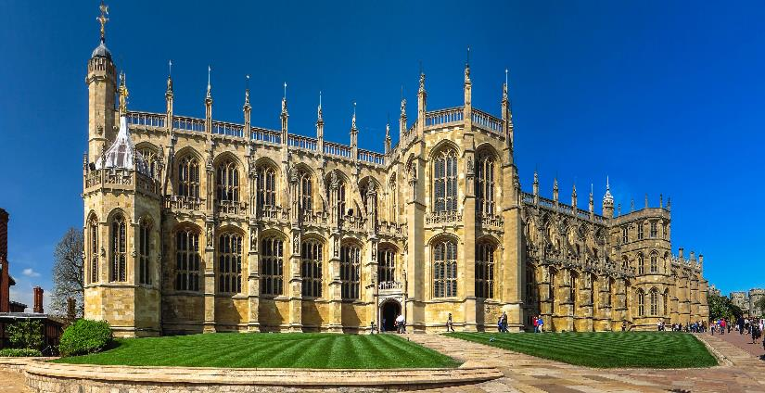
Today’s lab: Princes found?
In 1789, two unidentified child-sized coffins were found in a secret vault connected to Edward IV’s burial chamber in St. George’s Chapel at Windsor Castle.
While these remains were found in a chamber adjacent to the princes’ parents, no forensic analysis has been performed.
St. George’s Chapel

Slide 23
Today’s lab: Princes found?
There are two pairs of remains speculated to belong to the missing princes:
  Remains discovered in the Tower of London
  Remains discovered in St. George’s Chapel
In order for any testing to be performed, the sitting monarch must give consent, and this has not occurred.

Slide 24
Today’s lab: Your goal
Imagine that the English monarch has permitted the unknown remains to be analyzed.
You work in a lab specializing in DNA analysis of historical samples, and your team has been tasked with the testing.

Slide 25
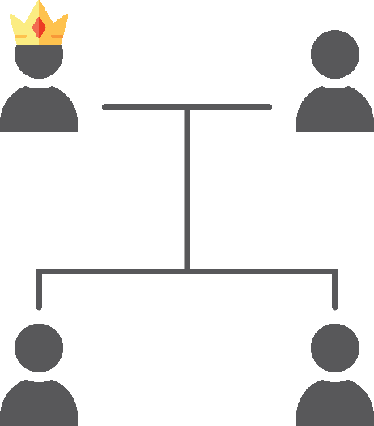
Today’s lab: Your goal
You will compare samples from the four sets of unknown remains to the parents of the lost princes.
This will allow you to determine if any of the unknown remains can be ruled out as belonging to the lost princes.
The lost princes’ parents,
buried at
St. George’s Chapel
King Edward IV
(father)
Elizabeth Woodville
(mother)
The lost princes, location unknown
Prince Edward
Prince Richard

Slide 26
Today’s lab: Your samples
You will test six samples:
Remains of King Edward IV (father of the princes)
Remains of Elizabeth Woodville (mother of the princes)
Unknown remains 1, from the Tower of London
Unknown remains 2, from the Tower of London
Unknown remains 3, from St. George’s Chapel
Unknown remains 4, from St. George’s Chapel

Slide 27







DNA testing
STR DNA
Bone fragment
DNA
STR copies
Compare lengths
Step 1:
DNA collection
Step 2:
PCR
Step 3:
Gel electrophoresis
You complete this step

Slide 28

Gel electrophoresis separates DNA by size
- - - NEGATIVE - - -
Negative molecules like DNA move towards the positive charge
The agarose gel forms a web
+ + + POSITIVE + + +

Slide 29
Gel electrophoresis separates DNA by size
- - - NEGATIVE - - -
Larger molecules move have more trouble moving through the web and travel slower
Smaller molecules move more easily through the web and travel faster
+ + + POSITIVE + + +

Slide 30

Gel electrophoresis
Different sized
pieces of DNA
Gel electrophoresis separates DNA by size.
Samples are placed in pockets called wells.
Smaller pieces of DNA travel farther through the gel.
Wells
Longer
DNA pieces
Shorter
DNA pieces

Slide 31

Interpreting gel electrophoresis results
There are two bands for Person X, indicating two different lengths of DNA at this STR region
Band 2 represents an STR allele with fewer repeats than Band 1, as smaller DNA fragments travel farther during gel electrophoresis.
Person X
Band 1
Band 2

Slide 32
Interpreting gel electrophoresis results
Person Y also has two bands, indicating two different lengths of DNA at this STR region.
These two alleles differ from those in Person X, as they traveled different distances on the gel.
Person X
Person Y
Band 3
Band 1
Band 4
Band 2

Slide 33
Interpreting gel electrophoresis results
There is a single band for Person Z, indicating that all DNA at this STR region is the same length.
Additionally, Band 4 from Person Y and Band 5 from Person Z traveled the same distance on the gel, which tells us that Person Y shares one allele with Person Z.
Person X
Person Y
Person Z
Band 3
Band 1
Band 4
Band 5
Band 2

Slide 34
Practice interpreting the results
Individual 1
Could Individual 1 be the biological offspring of Parent A and Parent B?
Parent A
Parent B

Slide 35
Practice interpreting the results
Individual 2
Could Individual 2 be the biological offspring of Parent A and Parent B?
Parent A
Individual 1
Parent B

Slide 36
Practice interpreting the results
Individual 3
Individual 2
Could Individual 3 be the biological offspring of Parent A and Parent B?
Parent A
Parent B
Individual 1

Slide 37
Practice interpreting the results
Individual 3
Individual 2
Individual 4
Could Individual 4 be the biological offspring of Parent A and Parent B?
Parent A
Parent B
Individual 1

Slide 38
Load your gel
Lane | Volume | Sample
1 | 10 μl | King Edward IV
2 | 10 μl | Elizabeth Woodville
3 | 10 μl | Unknown remains 1, from the Tower of London
4 | 10 μl | Unknown remains 2, from the Tower of London
5 | 10 μl | Unknown remains 3, from the St. George’s Chapel
6 | 10 μl | Unknown remains 4, from St. George’s Chapel
1
2
3
4
5
6

Slide 39

Interpreting the results
Biological parents of the missing princes
King Edward IV, the father of the princes, has one band, meaning he only carries one STR allele for this STR region.
All of King Edward’s offspring would inherit this STR allele from him.
King Edward IV
Elizabeth
Woodville

Slide 40

Interpreting the results
Biological parents of the missing princes
Elizabeth Woodville, the mother of the princes, also has one band, meaning she only carries one STR allele for this STR region.
All of Elizabeth Woodville’s offspring would inherit this STR allele from her.
King Edward IV
Elizabeth
Woodville

Slide 41
Interpreting the results
Biological parents of the missing princes
Taken together, we know that any biological offspring of King Edward IV and Elizabeth Woodville would have to carry these two STR alleles for this STR region.
If any of the unidentified remains don’t carry these two STR alleles, they can be eliminated as possibly belonging to Prince Edward or Prince Richard.
King Edward IV
Elizabeth
Woodville

Slide 42
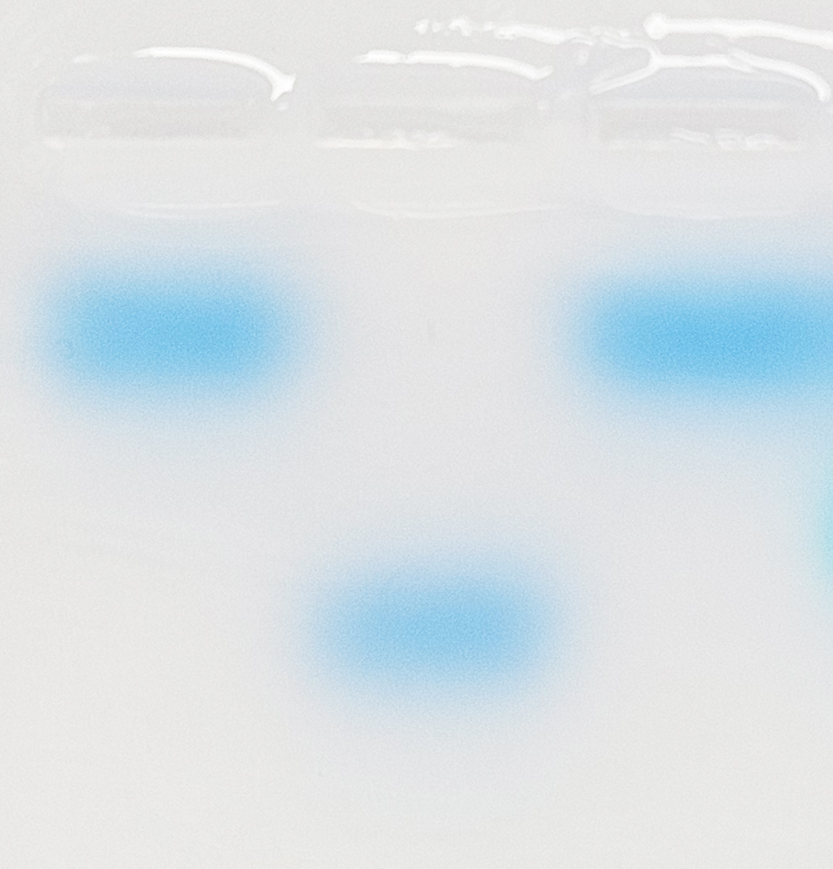
Interpreting the results
Biological parents of the missing princes
Unknown
remains
Unknown remains 1 lacks the STR allele passed down from the princes’ mother.
This set of remains can be eliminated as possibly belonging to the missing princes.
King Edward IV
Elizabeth
Woodville
Tower of London
1
2

Slide 43
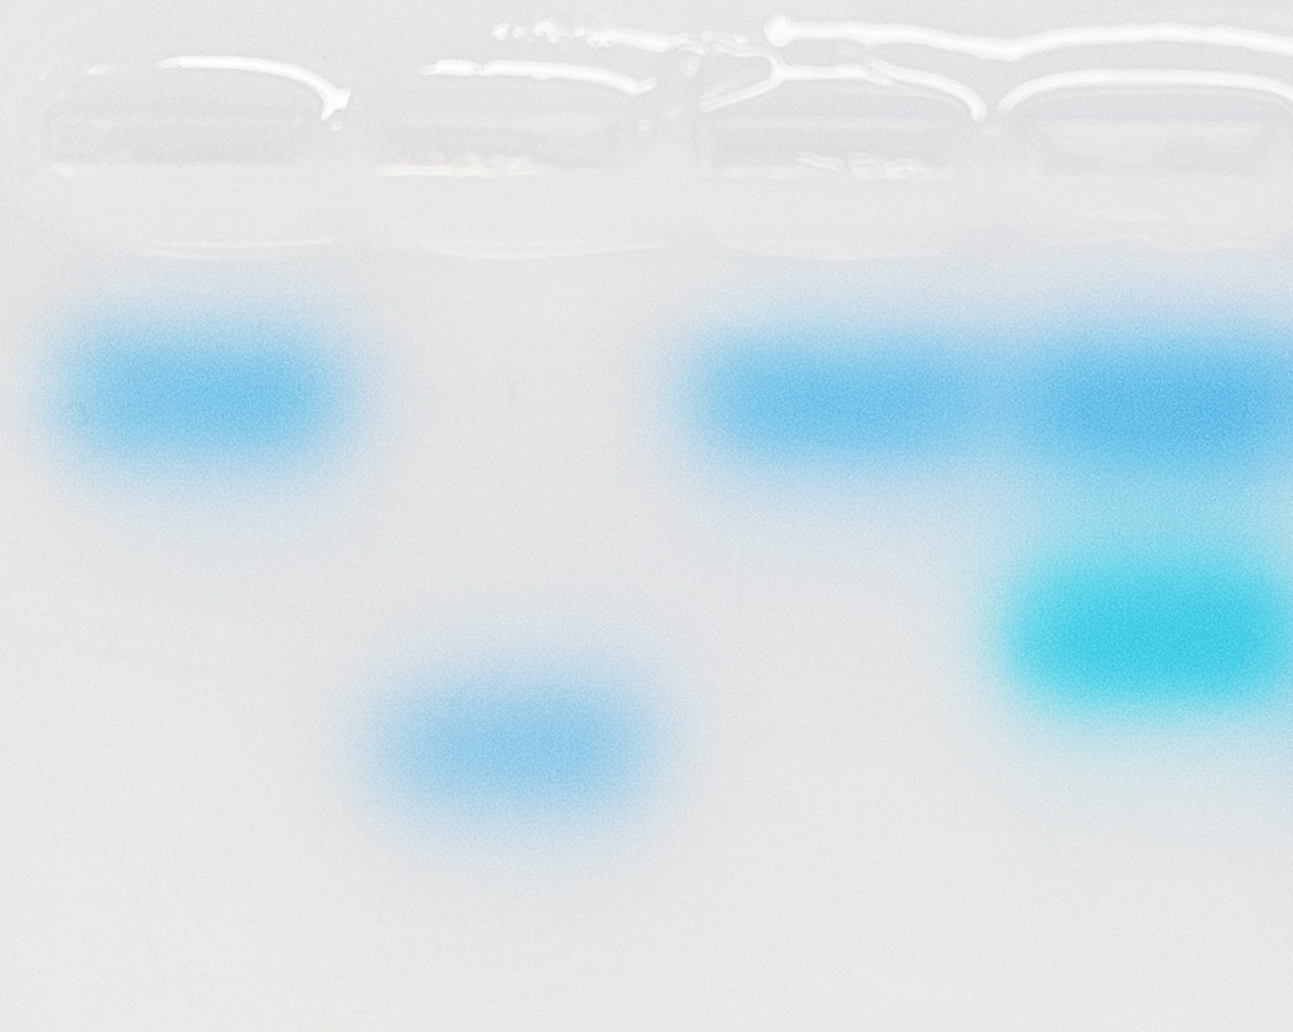
Interpreting the results
Biological parents of the missing princes
Unknown
remains
Unknown remains 2 carries an STR allele that could not have been inherited from the princes’ parents.
This set of remains can be eliminated as possibly belonging to the missing princes.
King Edward IV
Elizabeth
Woodville
Tower of London
1
2

Slide 44
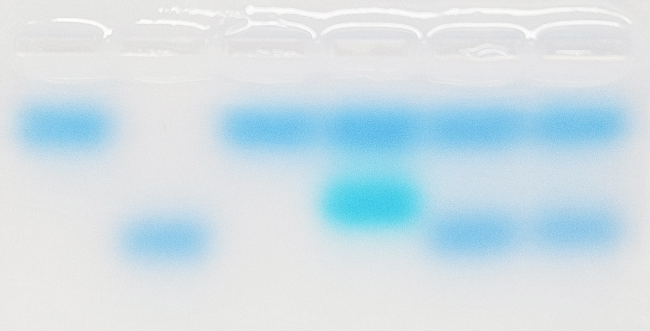
Interpreting the results
Biological parents of the missing princes
Unknown
remains
Unknown remains 3 and 4 both carry the appropriate STR alleles to be the biological offspring of King Edward IV and Elizabeth Woodville.
These remains could belong to the missing princes and warrant further testing.
King Edward IV
Elizabeth
Woodville
Tower of London
St. George’s Chapel
1
2
3
4

Slide 45
What have we learned?
STRs are variable regions of the DNA that can be used for identification.
STR genotypes can be used for familial matching.
We can even use STR analysis on historical remains!

Slide 46
A note on historical accuracy
The narrative involving the Princes in the Tower is based on historical records.
However, forensic DNA analysis has not been performed on the two pairs of remains speculated to belong to the princes.
Unless the sitting monarch orders DNA testing, the mystery shall remain!

