Slide 1
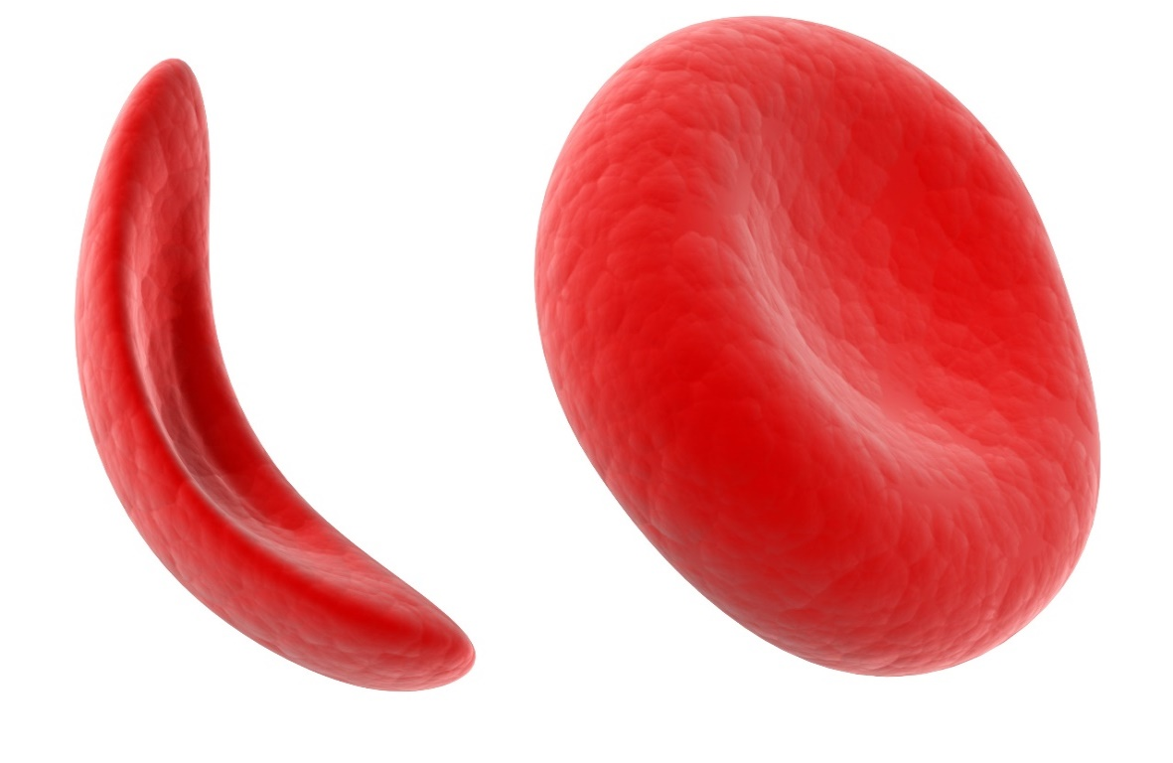
Sickle Cell Genetics
Diagnosing Baby Marie

Slide 2
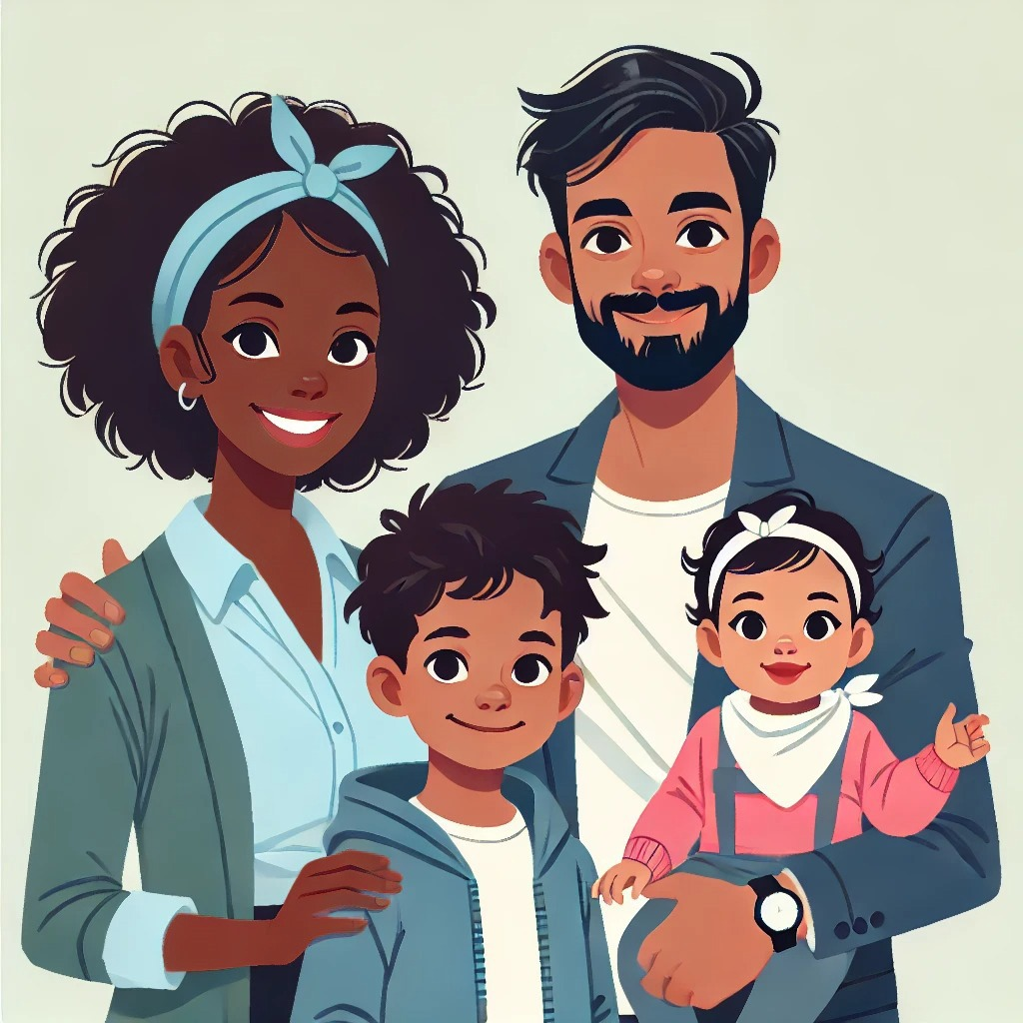
Today’s Lab
Jacqueline
Kumar
Baby Marie’s routine infant screening suggests that she might have sickle cell disease.
You will use gel electrophoresis to test baby Marie and her family for the sickle cell disease mutation.
Lewis
Marie

Slide 3
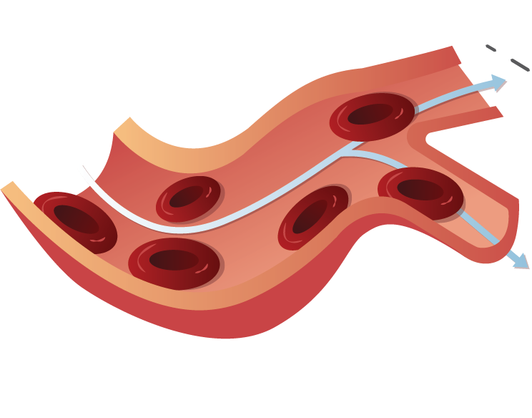
Red blood cells
Normal red blood cell
Red blood cells carry oxygen from the lungs to cells throughout our bodies.
Normal red blood cells are disk-shaped and very flexible, allowing them to squeeze through tiny capillaries in our circulatory system.
Red blood cells flow freely

Slide 4
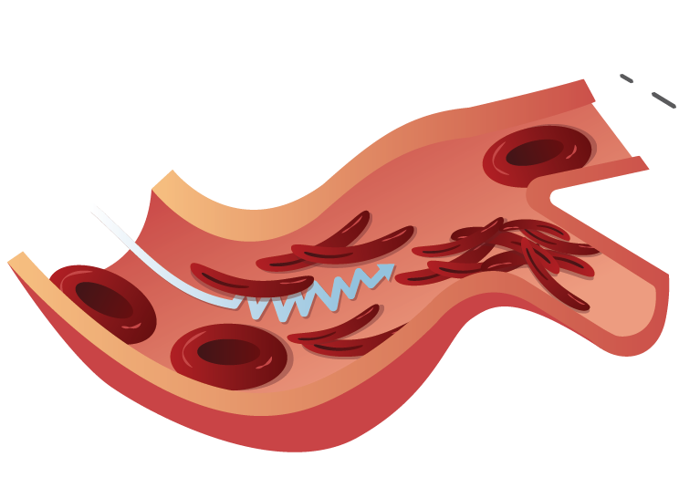
Sickle cell disease
Sickled red blood cell
Sickle cell disease is a condition that causes red blood cells to become crescent-shaped.
Sickled red blood cells clump together, creating blood flow blockages that can lead to infection, pain, or even death.
Blockage

Slide 5

Hemoglobin protein
Hemoglobin transports oxygen in your red blood cells.
Hemoglobin is composed of two α-globin and two β-globin subunits.

Slide 6
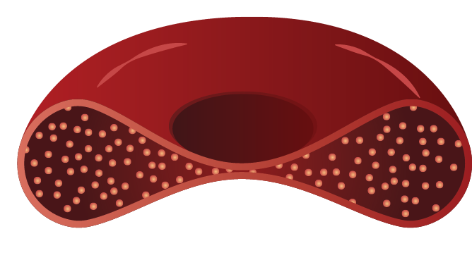
Hemoglobin protein
Hemoglobin A
Hemoglobin proteins move freely inside the cytoplasm of red blood cells.
This normal form of hemoglobin protein is called hemoglobin A.
Free-floating hemoglobin
Normal red blood cell

Slide 7

The sickle cell mutation
Sickle cell disease is caused by a mutation that substitutes a single DNA nucleotide in the β-globin gene.
The mutation leads to a single amino acid substitution in the β-globin protein and causes a hydrophobic amino acid to face the watery cytoplasm.
Mutated
amino acid

Slide 8
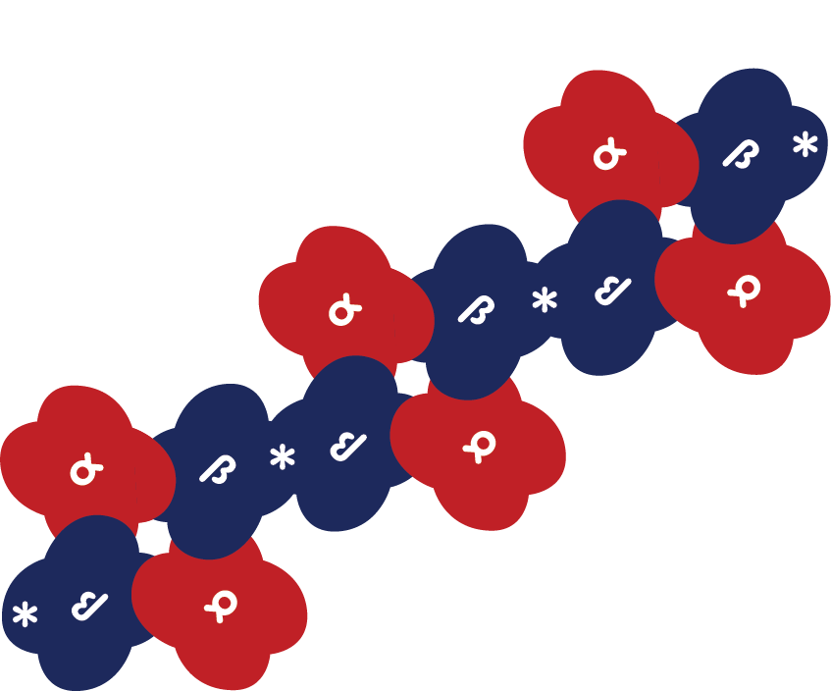

The sickle cell mutation
Hemoglobin S
strand
The mutated amino acids repel water and form hydrophobic links with each other, assembling long chains of hemoglobin proteins that distort the red blood cell into a sickle.
This abnormal form of hemoglobin protein is called hemoglobin S.
Sickled red blood cell

Slide 9
Inheritance of sickle cell disease
 | A | S
A | AA | AS
S | AS | SS
There are two alleles of the β-globin gene relevant to sickle cell disease:
  The normal β-globin allele (abbreviated “A” for hemoglobin A)
  The mutated sickle cell allele (abbreviated “S” for hemoglobin S)
Sickle cell disease follows a recessive inheritance pattern.
Sickle cell disease

Slide 10
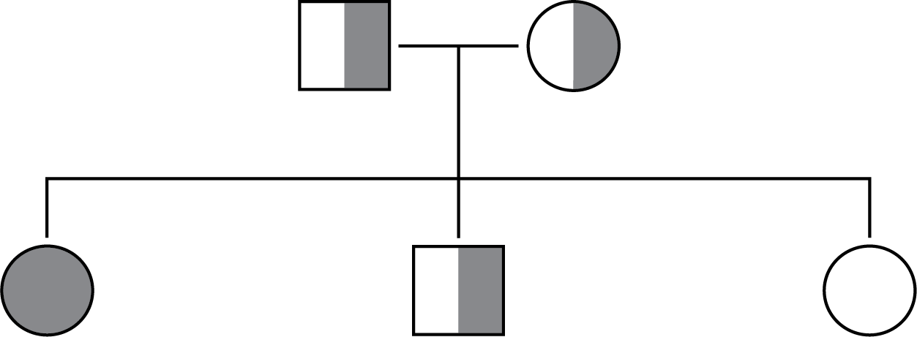
Inheritance of sickle cell disease
SS
Sickle cell disease
AS
Sickle cell trait
AA
Unaffected

Slide 11
Inheritance of sickle cell disease
Only individuals with two copies of the sickle cell allele have sickle cell disease
SS
Sickle cell disease
AS
Sickle cell trait
AA
Unaffected

Slide 12
Inheritance of sickle cell disease
Individuals with one copy of the sickle cell allele have sickle cell trait.
They have some hemoglobin clumping, but under normal conditions their red blood cells do not sickle.
SS
Sickle cell disease
AS
Sickle cell trait
AA
Unaffected

Slide 13
Inheritance of sickle cell disease
Individuals with two copies of the normal β-globin allele are unaffected.
AA individuals can only pass down the normal β-globin allele.
SS
Sickle cell disease
AS
Sickle cell trait
AA
Unaffected

Slide 14
Today’s lab
Jacqueline
Kumar
You are a doctor working with the Patels, who recently welcomed baby Marie to their family.
Marie’s routine newborn screening revealed low levels of normal hemoglobin, suggesting sickle cell disease.
Lewis
Marie

Slide 15
Today’s lab
Jacqueline
Kumar
Goal: you will use DNA testing to determine whether Marie has sickle cell disease!
Because sickle cell disease is inherited, you will also test Marie’s parents, Jacqueline and Kumar, and her older brother, Lewis, to determine if they carry the sickle cell allele.
Lewis
Marie

Slide 16
Baby Marie’s family
Jacqueline
Kumar
Mother Jacqueline: 32-year-old female. She is primarily of African descent, which can be a risk factor for carrying the sickle cell allele.
Father Kumar: 32-year-old male born in India. Indian descent can be a risk factor for carrying the sickle cell allele.
Lewis
Marie

Slide 17
Baby Marie’s family
Jacqueline
Kumar
Brother Lewis: Healthy 4-year-old boy. Did not show any abnormalities in his routine infant screening.
Baby Marie: 2 months old. Newborn screening suggests that she might have sickle cell disease.
Lewis
Marie

Slide 18


DNA testing
A blood or tissue sample is taken from the patient. DNA is then collected from that sample.
Blood
sample
DNA
DNA
collection

Slide 19

DNA testing
β-globin gene
PCR makes billions of copies of a 400 bp section of the
β-globin gene
Blood
sample
Portion of
β-globin gene
DNA
DNA
collection
Polymerase chain reaction

Slide 20

DNA testing
Next, a step to identify the sickle cell mutation is performed. This is explained next.
β-globin gene
Blood
sample
Portion of
β-globin gene
DNA
DNA
collection
Polymerase chain reaction
Step 3:
Restriction digest
Restriction digestion

Slide 21
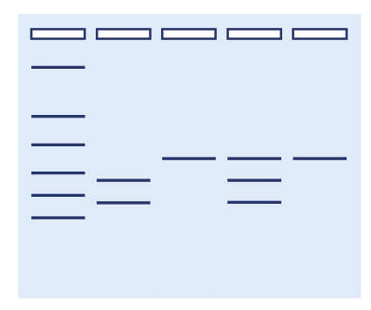
DNA testing
β-globin gene
Blood
sample
Portion of
β-globin gene
Determine genotypes!
DNA
DNA
collection
Polymerase chain reaction
Step 3:
Restriction digest
Restriction digestion
Gel
electrophoresis
Already done
You complete this step

Slide 22
Restriction digestion
Restriction enzymes recognize specific short DNA sequences and cut the DNA there.
This lab uses a restriction enzyme that cuts a DNA sequence found only in the normal β-globin allele.
The sickle cell mutation changes this sequence, so the sickle cell allele is not cut by the restriction enzyme.

Slide 23
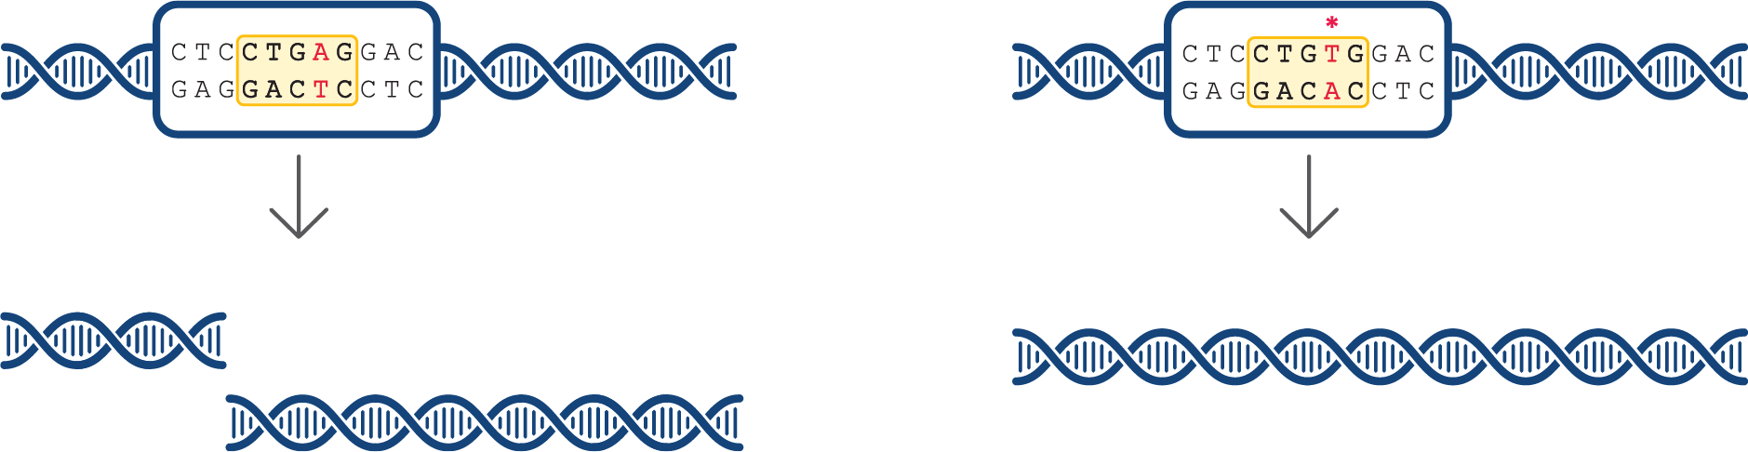
Identifying the sickle cell allele via restriction digestion
Normal β-globin allele
Sickle cell allele
Restriction enzyme cuts DNA
MUTATION = Restriction enzyme does NOT cut DNA
400 bp PCR product
DNA cut
DNA not
cut
150 bp
400 bp
250 bp

Slide 24
Identifying the sickle cell allele via restriction digestion
Normal β-globin allele
Sickle cell allele
Restriction enzyme cuts DNA
MUTATION = Restriction enzyme does NOT cut DNA
You will use gel electrophoresis to separate and visualize these DNA fragments.
This will allow you to determine which alleles each member of the Patel family carries!
400 bp PCR product
DNA cut
DNA not
cut
150 bp
400 bp
250 bp

Slide 25
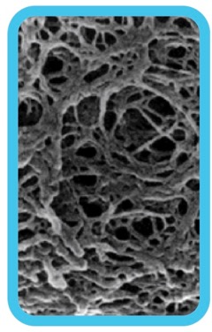
Gel electrophoresis separates DNA by size
- - - NEGATIVE - - -
Negative molecules like DNA move towards the positive charge
The agarose gel forms a web
+ + + POSITIVE + + +

Slide 26
Gel electrophoresis separates DNA by size
- - - NEGATIVE - - -
Larger molecules move have more trouble moving through the web and travel slower
Smaller molecules move more easily through the web and travel faster
+ + + POSITIVE + + +

Slide 27

Gel electrophoresis
Different sized
pieces of DNA
Gel electrophoresis separates DNA by size.
Samples are placed in pockets called wells.
Smaller pieces of DNA travel farther through the gel.
Longer
DNA pieces
Shorter
DNA pieces

Slide 28
Gel electrophoresis
A DNA ladder contains pieces of DNA of known lengths.
Comparing to the ladder allows you to estimate the size of the DNA in your samples.
Ladder
Base
Pairs
1200 -
700 -
500 -
300 -
200 -
~ 250 bp
100 -
~ 150 bp

Slide 29
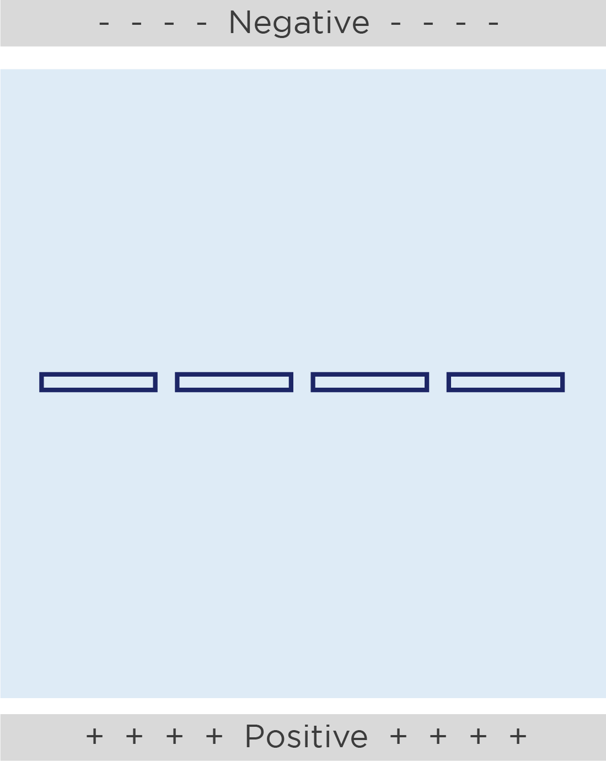
Gel loading tips
Gels have pockets called wells where we will add our samples.
The wells are a small target, so put your elbows on the table and hold the pipette with two hands.
Cross section of well

Slide 30


Gel loading tips
Pipette tip
Top of well
Place the micropipette tip just inside the opening of the well. Wiggle the tip back and forth to feel that the tip is in the well.
Do not stab your tip into the bottom of the well. The tip will either clog with gel or puncture the bottom of the well.
Too deep!

Slide 31
Load the gel
DL
J
K
L
M
Well 1: 10 μl DNA Ladder (tube DL)
Well 2: 10 μl Jacqueline DNA (tube J)
Well 3: 10 μl Kumar DNA (tube K)
Well 4: 10 μl Lewis DNA (tube L)
Well 5: 10 μl Marie DNA (tube M)

Slide 32
Interpreting the gel electrophoresis results
Normal β-globin allele
AA genotype
Ladder
CTCCTGAGGAC
GAGGACTCCTC
Base
Pairs
1200
700
DNA cut
500
What will this look like on the gel?
300
250 bp
200
150 bp
150 bp
100
250 bp

Slide 33
Interpreting the gel electrophoresis results
Sickle cell allele
AA genotype
SS genotype
Ladder
*
CTCCTGTGGAC
GAGGACACCTC
Base
Pairs
1200
700
DNA not cut
500
What will this look like on the gel?
400 bp
300
200
400 bp
100

Slide 34
Interpreting the gel electrophoresis results
AA genotype
AS genotype
SS genotype
Ladder
Base
Pairs
1200
700
500
400 bp
What will this look like on the gel?
300
250 bp
200
150 bp
100

Slide 35
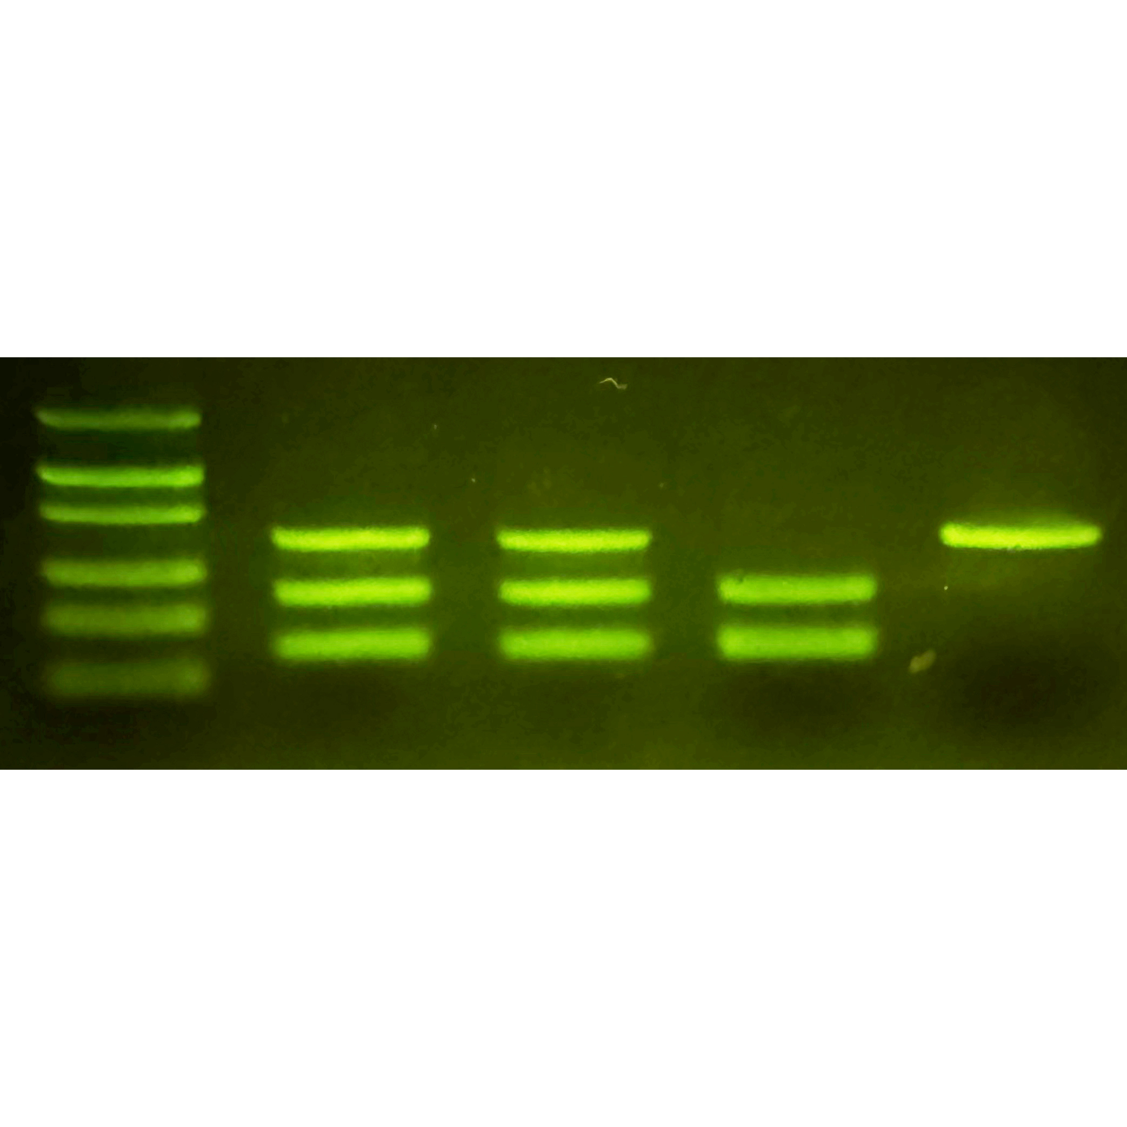

Expected results
J
Base
pairs
1,200 -
700 -
500 -
400 bp
300 -
250 bp
200 -
150 bp
100 -
 | Jacqueline | Kumar | Lewis | Marie
Sickle cell allele (400 bp)
Normal β-globin allele (250 + 150 bp)
Genotype
Phenotype
AS
Sickle cell trait

Slide 36
Expected results
J
K
Base
pairs
1,200 -
700 -
500 -
400 bp
300 -
250 bp
200 -
150 bp
100 -
 | Jacqueline | Kumar | Lewis | Marie
Sickle cell allele (400 bp)
Normal β-globin allele (250 + 150 bp)
Genotype
Phenotype
AS
AS
Sickle cell trait
Sickle cell trait

Slide 37
Expected results
J
K
L
Base
pairs
1,200 -
700 -
500 -
300 -
250 bp
200 -
150 bp
100 -
 | Jacqueline | Kumar | Lewis | Marie
Sickle cell allele (400 bp)
Normal β-globin allele (250 + 150 bp)
Genotype
Phenotype
AS
AS
AA
Sickle cell trait
Sickle cell trait
Unaffected

Slide 38
Expected results
J
K
L
M
Base
pairs
1,200 -
700 -
500 -
400 bp
300 -
200 -
100 -
 | Jacqueline | Kumar | Lewis | Marie
Sickle cell allele (400 bp)
Normal β-globin allele (250 + 150 bp)
Genotype
Phenotype
AS
AS
AA
SS
Sickle cell trait
Sickle cell trait
Unaffected
Sickle cell disease

Slide 39
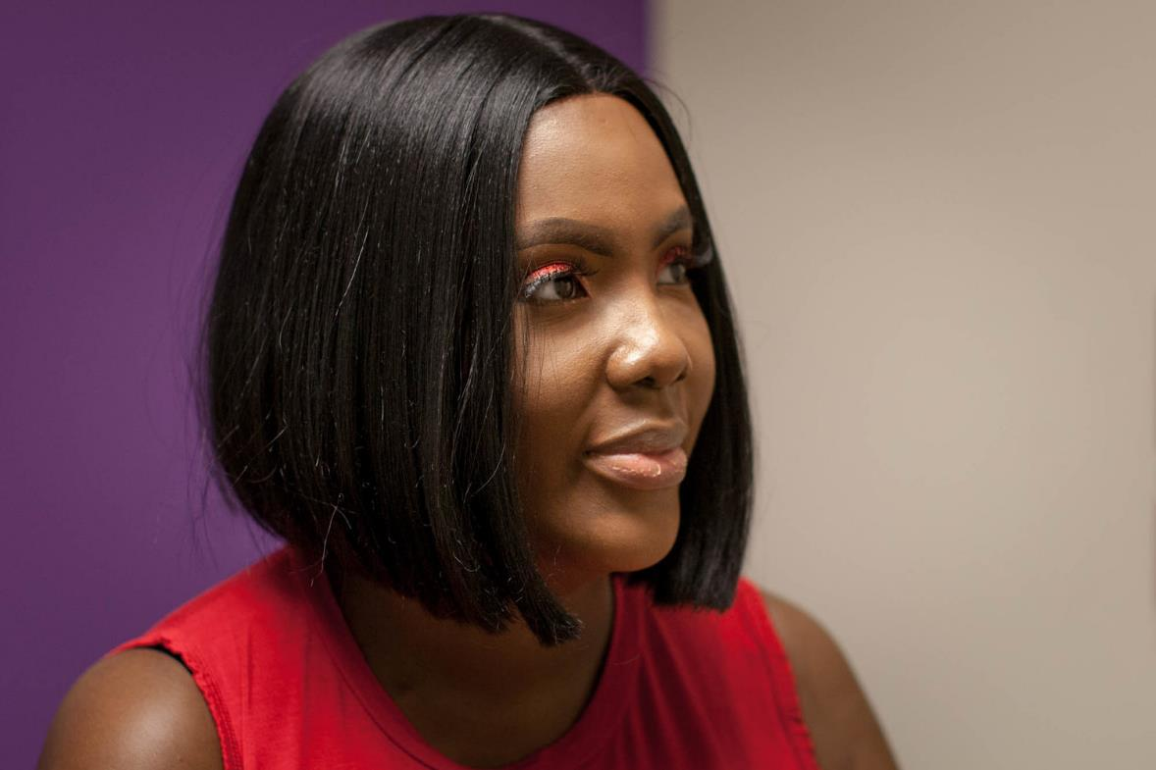
Living with sickle cell disease
Antibiotics administered regularly up to age 5.
Medications can reduce regularity and severity of pain crises.
Bone marrow transplants may allow patients to produce unaffected red blood cells.
Recent advances in CRISPR/Cas gene therapy.
Victoria Gray, the first person to receive the CRISPR gene-editing treatment for sickle cell disease

Slide 40
What have we learned?
Sickle cell disease is caused by a mutation that causes hemoglobin proteins to stick together, which distorts red blood cells into a sickle.
Sickle cell disease can be diagnosed using DNA testing.

Slide 41
Extension activity:
Sickle cell disease gene therapy
Background on CRISPR/Cas
Background on the CRISPR/Cas sickle cell disease gene therapy

Slide 42
Genome editing
By editing the genome, we can counteract the mutations that cause genetic diseases like sickle cell disease.
Until recently, genome editing was very difficult.

Slide 43
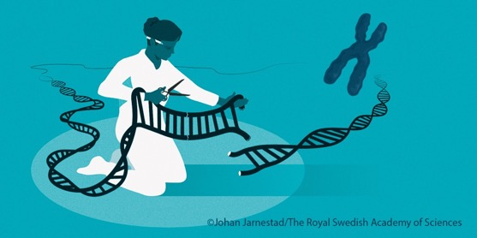
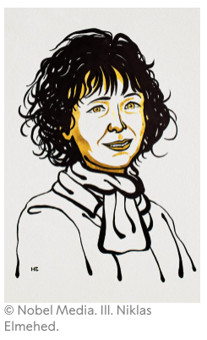
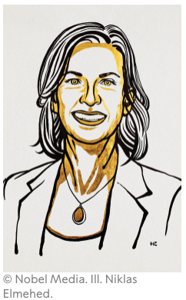
CRISPR/Cas is a revolutionary gene editing technique
Compared to other gene editing methods, CRISPR is:
  Specific, providing tight control over where in the genome changes occur.
  Easy to use.
Emmanuelle Charpentier & Jennifer A. Doudna received the 2020 Nobel Prize for their work.
https://www.nobelprize.org/prizes/chemistry/2020/press-release/

Slide 44
Sickle cell disease gene therapy
The first clinically tested and approved gene therapy for sickle cell disease used CRISPR/Cas to disable a gene.
The following slides explain this approach.
Victoria Gray, the first person to receive the CRISPR gene-editing treatment for sickle cell disease

Slide 45
Fetal hemoglobin
During fetal development, humans produce a different form of hemoglobin.
Fetal hemoglobin has two α-globin subunits and two γ-globin subunits.
Around birth, our cells stop producing γ-globin and start making β-globin.

Slide 46
Sickle cell disease gene therapy
Fetal hemoglobin still works in adult cells.
Rare individuals with persistent fetal hemoglobin are protected from sickle cell disease.
Scientists wanted to treat sickle cell disease by making adult red blood cells produce fetal hemoglobin again.

Slide 47
BCL11A protein prevents γ-globin production
Before birth
A protein called BCL11A inhibits γ-globin production.
Before birth, BCL11A protein is not expressed, so there is high γ-globin production.
BCL11A
regulatory switch
BCL11A
protein
γ-globin
production

Slide 48
BCL11A protein production is turned off around birth
Before birth
After birth
Around birth, a genetic switch flips that turns on production of BCL11A.
This decreases γ-globin production.
BCL11A
regulatory switch
BCL11A
regulatory switch
BCL11A
protein
BCL11A
protein
γ-globin
production
γ-globin
production

Slide 49
Sickle cell disease gene therapy
Scientists used CRISPR/Cas to disrupt the BCL11A regulatory switch in blood cells.
This decreases BCL11A protein production.
γ-globin production increases as a result.
TREATMENT
BCL11A
regulatory switch
BCL11A
protein
γ-globin
production
You will use paper to model how CRISPR/Cas was used to accomplish this!

Slide 50
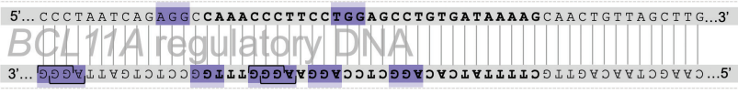
Your target: BCL11A regulatory switch
You can disable the switch by interfering with this “Achilles’ heel” region

Slide 51


CRISPR/Cas system components
Cas9 protein (red)
Cas protein: a nuclease that cuts DNA
Guide RNA: a small RNA that determines where it will cut the DNA
Guide
RNA
(yellow)

Slide 52
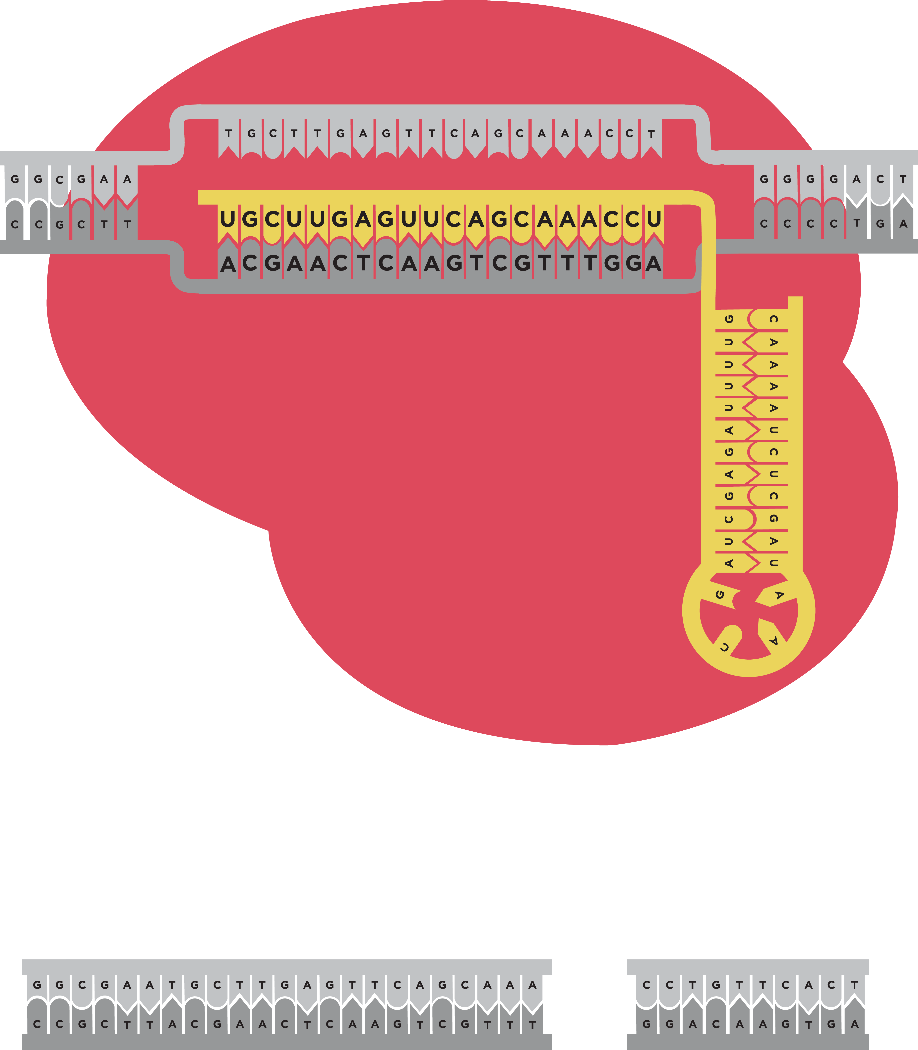
CRISPR targeting
Cas9 only cuts the DNA when the guide RNA binds to a complementary sequence.
Complementary
You will use a custom guide RNA to guide Cas9 to the BCL11A “Achilles’ heel” sequence.
Cas9 cuts
DNA

Slide 53
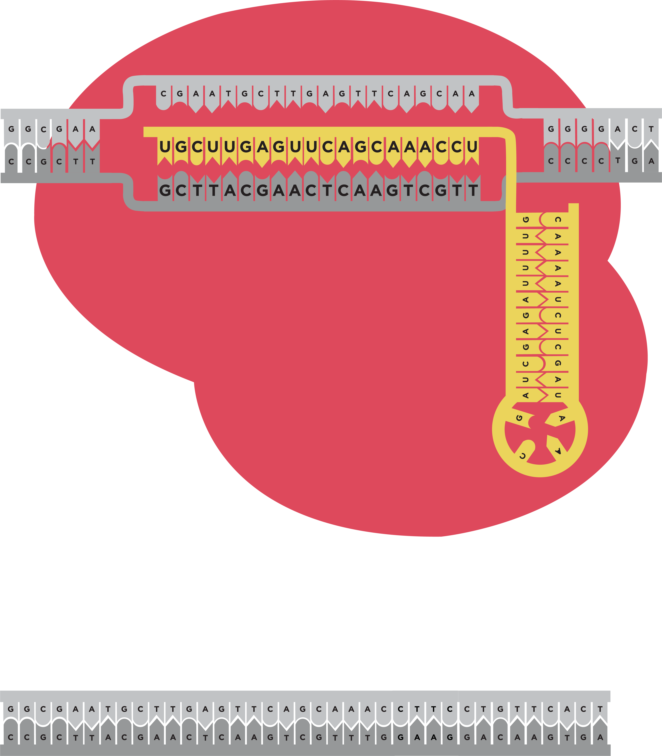
NOT
complementary
Complementary
Cas9 does
NOT cut DNA
Cas9 cuts
DNA

Slide 54






CRISPR in action
Target DNA
Cas9
3. The gene is disabled
1. Guide RNA binds to Cas9
2. If guide RNA finds complementary region of target DNA, Cas9 makes a cut
Guide RNA

