Slide 1

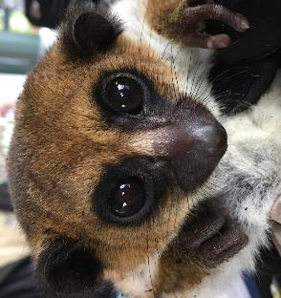
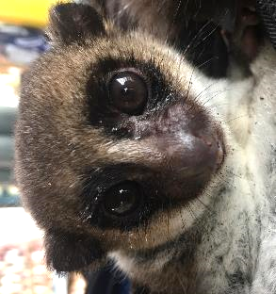
Conservation Genetics Lab
Identifying Lemur Diversity

Slide 2
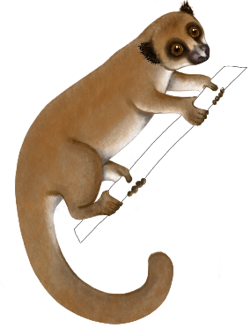
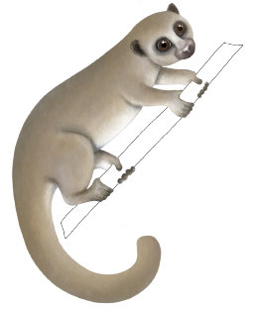
Welcome!
Our goals for today
Explore lemurs as model for both conservation and evolution.
Use modern genetic tools to gather evidence from evolution to track species relationships.
Gain insights into biodiversity and conservation.
Artwork:
Sally Bornbusch

Slide 3


Slide 4
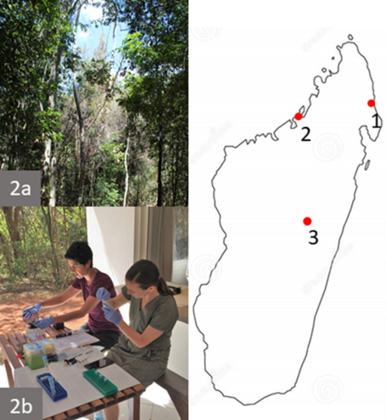
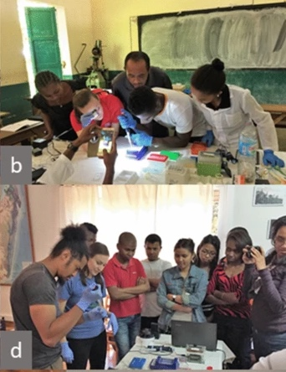
Equipment at use in the field
and in outreach
Blanco, M.B., Greene, L.K., Rasambainarivo, F. et al. Next-generation technologies applied to age-old challenges in Madagascar. Conserv Genet 21, 785–793 (2020).

Slide 5
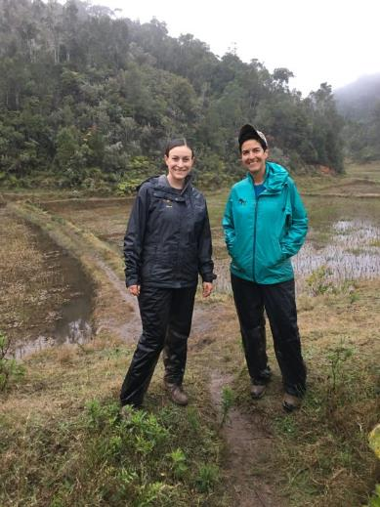

Duke Lemur Center
Dr. Lydia Greene
Dr. Marina Blanco

Slide 6
Today’s lab
Have researchers discovered a thought-to-be-extinct species of lemur?
Using the tools of genetics and evolutionary biology to inform important questions surrounding biodiversity and conservation.

Slide 7
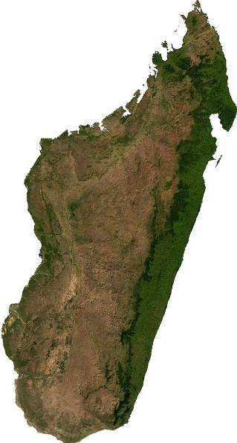

Lemurs of Madagascar
Madagascar

Slide 8
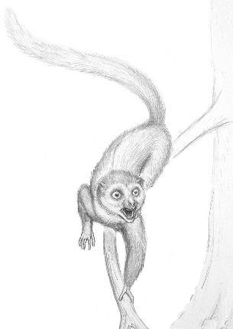
Lemurs of Madagascar
Bogdan Bocianowski (2009). "Complete Primate Skeleton from the Middle Eocene of Messel in Germany: Morphology and Paleobiology" (PDF). PLoS ONE 4 (5): e5723.

Slide 9
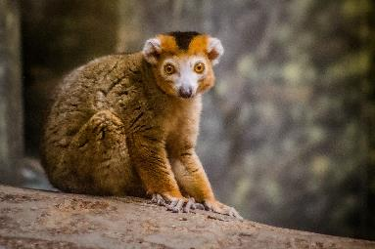
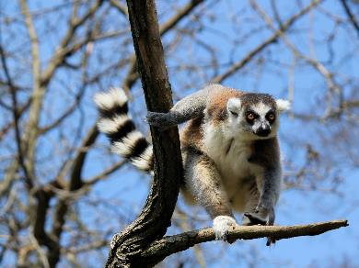
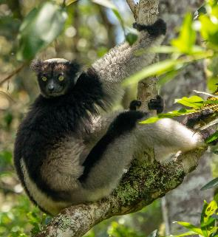
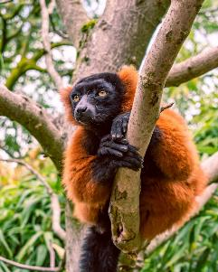
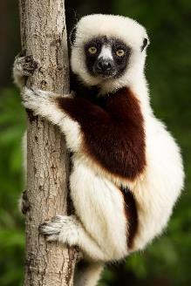
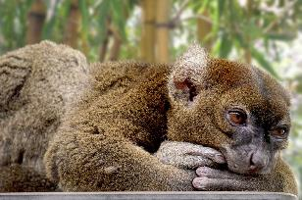
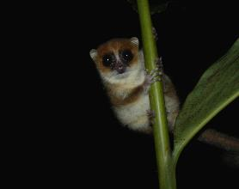
Lemurs of Madagascar
Bogdan Bocianowski (2009). "Complete Primate Skeleton from the Middle Eocene of Messel in Germany: Morphology and Paleobiology" (PDF). PLoS ONE 4 (5): e5723.

Slide 10
Lemurs of Madagascar
Primates
Grasping hands with nails instead of claws
Binocular vision
Arboreal (most live in trees)
Around 100 different species
Largest ever was the extinct Archaeoindris fontoynontii
  About 350 lbs (160 kg)

Slide 11
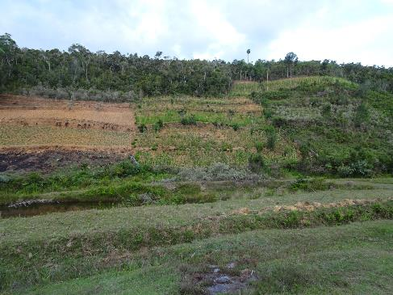
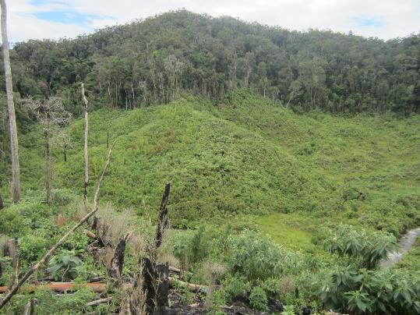
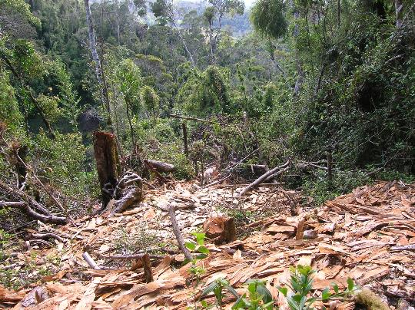
Habitat change on Madagascar
Forests of Madagascar are significantly smaller and more fragmented today than they ever were historically.
Effects of agriculture
Harvesting of lumber
Climate change

Slide 12
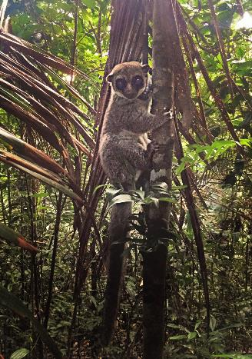
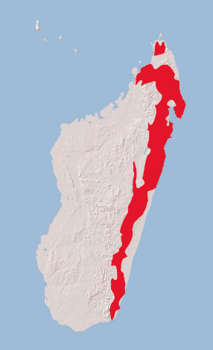
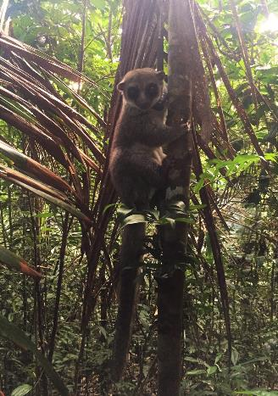
Cheirogaleus major – the greater dwarf lemur
Cheirogaleus major
Once thought to be one of only two species of dwarf lemur alive today.
Genetic technology has allowed researchers to realize there are several lemur species once thought to be C. major.
Photo: Marina Blanco
Map modified from IUCN website

Slide 13
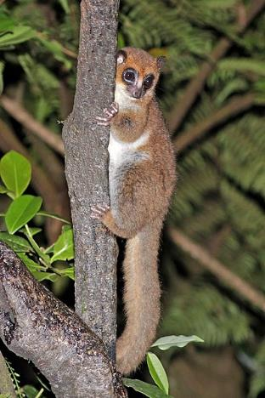
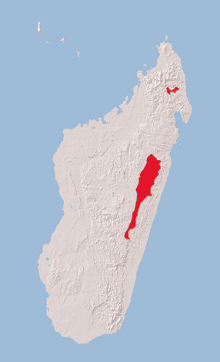
C. crossleyi – furry-eared dwarf lemur
Cheirogaleus crossleyi
Considered “vulnerable” by the IUCN
One of the largest populations is at the forest reserve at Tsinjoarivo
Photo: Charles Sharp CC4.0
Map modified from IUCN website

Slide 14
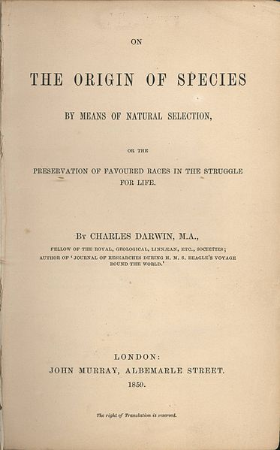
Species concepts
Warning: Danger Zone!
“Species” can be very difficult to define, and different precise definitions exist depending on the context.
Our definition: A group of animals that can regularly reproduce together in the wild and that shares a particular set of characteristics and evolutionary history.
“In determining whether a form should be ranked as a species or a variety, the opinion of naturalists having sound judgment and wide experience seems the only guide to follow.”
-The origin of species, p. 50

Slide 15
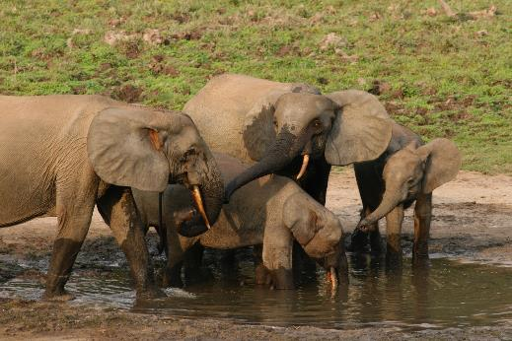
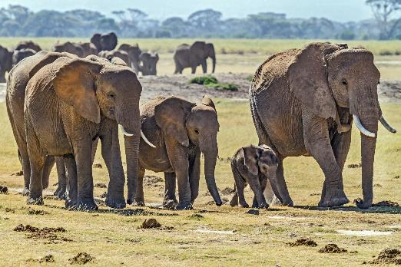
Cryptic species
Species that are difficult or impossible to tell apart from morphology alone.
Loxodonta cyclotis
African forest elephant
Loxodonta africana
African bush elephant

Slide 16
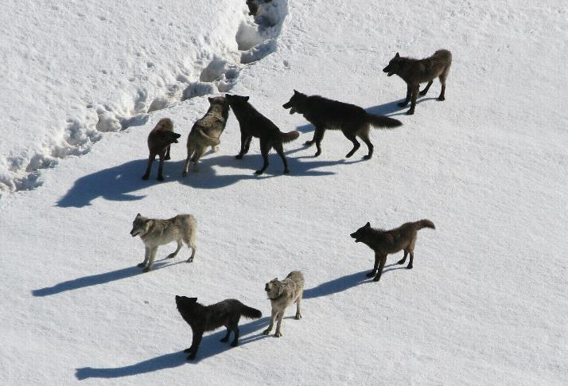
Other species contain significant variation
This pack of wolves is all one species and presumably all closely related
Yet they show significant variation

Slide 17

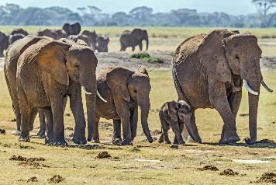
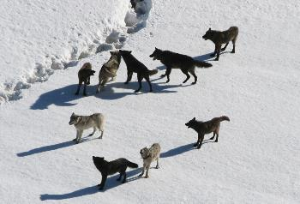
Morphology is important
, but genetics rules!

Slide 18
C. crossleyi – furry-eared dwarf lemur
Cheirogaleus crossleyi
Lemurs at Tsinjoarivo seem to show more variation than you would expect to find in a single lemur species.
Have we discovered another species of lemur?
Is this a population with more variation than expected?
Tsinjoarivo
Photo: Charles Sharp CC4.0
Map modified from IUCN website

Slide 19
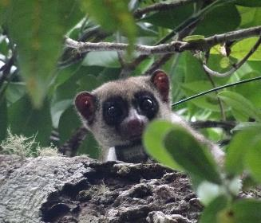
C. sibreei – Sibree’s dwarf lemur
Thought to be extinct
Known from a single museum specimen.
  Due to regulations no biological samples are allowed to be taken.
Some individuals at Tsinjoarivo seem to resemble this “lost” species.
Photo:
Marina Blanco

Slide 20
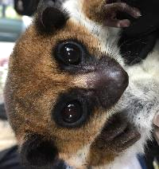

Workflow overview
Morphological analysis
Preliminary
PCR-RFLP analysis
Sequence analysis

Slide 21
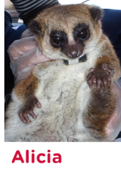
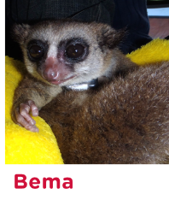
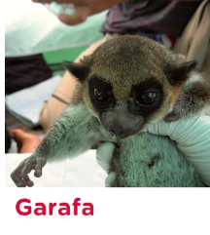
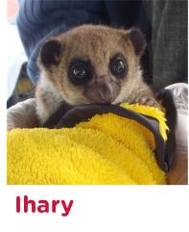
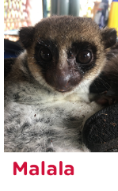
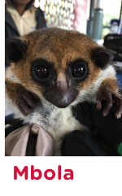
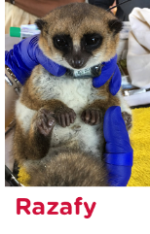
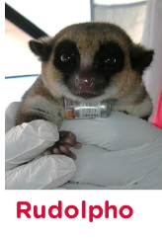
Let’s meet the lemurs!

Slide 22
Workflow overview
Morphological analysis
Preliminary
PCR-RFLP analysis
Sequence analysis

Slide 23
Workflow overview
Morphological analysis
Preliminary
PCR-RFLP analysis
Sequence analysis

Slide 24
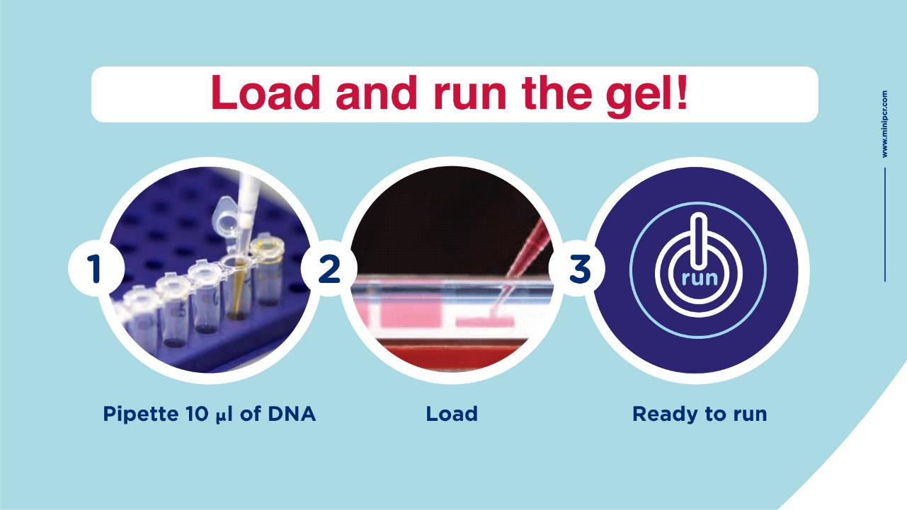
© 2019 by Amplyus LLC

Slide 25
Workflow overview
Morphological analysis
Preliminary PCR-RFLP analysis
Sequence analysis

Slide 26
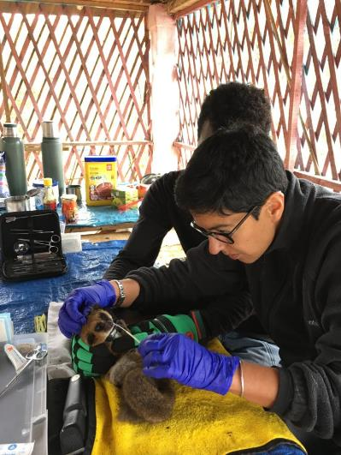
Taking morphological data
Data based form and structure
Lemurs are captured and brought back to the field station to be measured.
A sample of DNA is taken.
The lemur is then returned to from where it was captured.
Photo: Duke Lemur Center

Slide 27
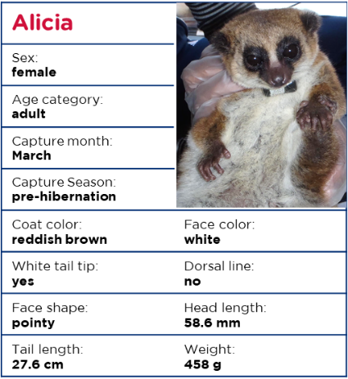
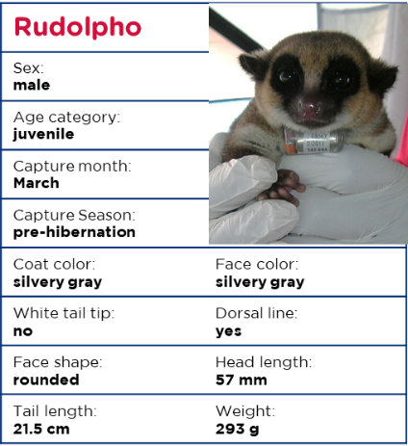
Meet the lemurs

Slide 28
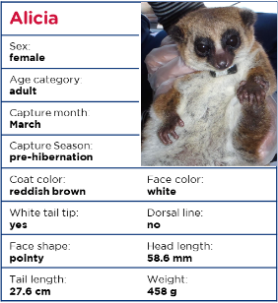
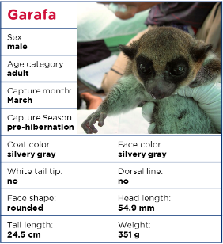
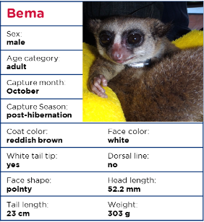
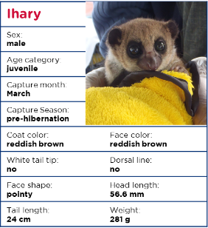
Meet the lemurs

Slide 29
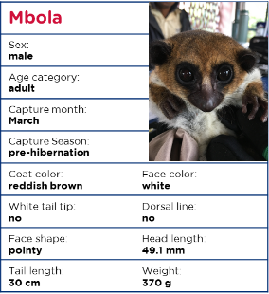
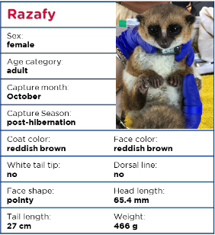


Meet the lemurs

Slide 30

Marina’s hypothesis: size
Possible C. crossleyi
Possible C. sibreei
mass: 370 g – 466 g
mass: 281 g – 351 g
Malala

Slide 31
Jean-Basile’s hypothesis: coat color
Possible C. crossleyi
Possible C. sibreei
reddish brown
silvery gray
Malala

Slide 32
Jules’s hypothesis: single species
Possible C. crossleyi
Possible C. sibreei
reddish brown
silvery gray
Malala

Slide 33
Workflow overview
Morphological analysis
Preliminary
PCR-RFLP analysis
Sequence analysis

Slide 34

Testing for different species
The best evidence for species is from genetics
Traditionally the mitochondrial gene cytochrome B (cyt-B) is used.
1140 bp gene located in the mitochondrial genome.
Mitochondrial genes evolve at a rate the there tends to be:
  enough differences between closely related species to tell them apart
  not too many differences within a species

Slide 35
PCR-RFLP analysis
Polymerase Chain Reaction - Restriction Fragment Length Polymorphism
C. Crossleyi
(furry-eared dwarf lemur)
There is a polymorphism at base pair 682 of the cyt-B gene that is unique to C. crossleyi.
This polymorphism is part of a BglII restriction enzyme cut site.
TAAA
ATTTCTAG
GATCTACT
ATGA
z
Other dwarf lemurs
TAAAGACCTATT
ATTTCTGGATAA

Slide 36

The Polymerase Chain Reaction
Find and replicate a specific DNA target

Slide 37

Restriction enzymes
Recognize specific DNA sequences and cut the DNA
5’…AGATCT…3’
3’…TCTAGA…5’
BglII
TAAA
ATTTCTAG
GATCTACT
ATGA

Slide 38
PCR-RFLP
5’…AGATCT…3’
3’…TCTAGA…5’
BglII
Restriction fragment length polymorphism
C. Crossleyi
(furry-eared dwarf lemur)
TAAA
ATTTCTAG
GATCTACT
ATGA
Other dwarf lemurs
TAAAGACCTATT
ATTTCTGGATAA

Slide 39
Experiment review
BglII cut site
1200 bp DNA fragment
Restriction enzyme will cut DNA from C. crossleyi
(furry-eared dwarf lemur)
Restriction enzyme will NOT cut DNA from other species of lemur
1200 bp DNA fragment
700 bp DNA fragment
Based on morphology, likely C. sibreei
(Subree’s dwarf lemur)
500 bp DNA fragment

Slide 40

Agarose gel electrophoresis
1,200
700
500
300
200
100

Slide 41
Let’s look at the gel!

Slide 42









Let’s look at the gel!

Slide 43
Results!
Ladder
Alicia
Bema
Garafa
Ihary
Malala
Mbola
Razafy
Rudolpho
1,200
700
500
300
200
100
2 bands (500 & 700 bp) – C. crossleyi
(furry-eared dwarf lemur)
1 band (1200 bp) – Other/C. sibreei
(Sibree’s Dwarf lemur)

Slide 44
Results!
Ladder
Alicia
Bema
Garafa
Ihary
Malala
Mbola
Razafy
Rudolpho
1,200
700
500
300
200
100
2 bands (500 & 700 bp) – C. crossleyi
(furry-eared dwarf lemur)
1 band (1200 bp) – Other/C. sibreei
(Sibree’s Dwarf lemur)

Slide 45
Results!
C. crossleyi
Furry-eared dwarf lemur
C. sibreei
Sibree’s dwarf lemur

Slide 46



WE RE-DISCOVERED A SPECIES!!!!

Slide 47
Not the end of the story

Slide 48


Trapping success by year
Analyze trap data to evaluate trends over time.
Year | Trap nights | Total # lemurs trapped
2006 | 100 | 7
2007 | 200 | 15
2009 | 300 | 14
2011 | 900 | 17
2013 | 900 | 19
2014 | 900 | 11
2019 | 600 | 10

Slide 49
Trapping success by year

Slide 50


Percent species caught by year
Sibree’s dwarf lemur
furry-eared
dwarf lemur

Slide 51


Generalists vs. Specialists

Slide 52
Workflow overview
Morphological analysis
Preliminary PCR-RFLP analysis
Sequence analysis

Slide 53

Sequence data
Use the tools of evolutionary biology and bioinformatics to establish species relationships
We provide the entire cyt-B gene sequence for:
Each lemur in this study
Three C. medius individuals
Three C. major individuals
Microcebus murinus

Slide 54





Example cladogram
Time
Lion
Leopard
Jaguar
Tiger
Snow leopard

Slide 55

Sequence data
https://www.ebi.ac.uk/Tools/phylogeny/simple_phylogeny/

Slide 56

Cladogram from simple phylogeny
Gray mouse lemur
C. sibreei
Sibree’s dwarf lemur
Fat-tailed dwarf lemur
Greater dwarf lemur
C. crossleyi
Furry-eared dwarf lemur

Slide 57

C. sibreei today
Considered “critically endangered” by the IUCN
Found only in a few fragmented patches of forest

Slide 58


Summary
Used modern genetic techniques to analyze authentic data and re-discover a “lost” species of lemur.
Explored how genetic techniques can force us to rethink biodiversity and approaches to conservation.
Used the tools of evolutionary biology to build species relationships.

Slide 59

Questions
How close are the techniques used in this lab to ones actually used in the field?
Is there a way to do this lab remotely?
What resources are available now and when will the lab be released?

Slide 60




Summary
Made predictions based on morphological traits.
Tested our predictions using genetic techniques.
Used molecular approaches to discover a species thought to be extinct!
Analyzed field data to measure the relative
Used the tools of evolutionary biology

